Slide 1
Department of Transport Logistics
Importance of industrial tracks in the Republic of Croatia
Asst. Prof. Nikolina Brnjac

Slide 2

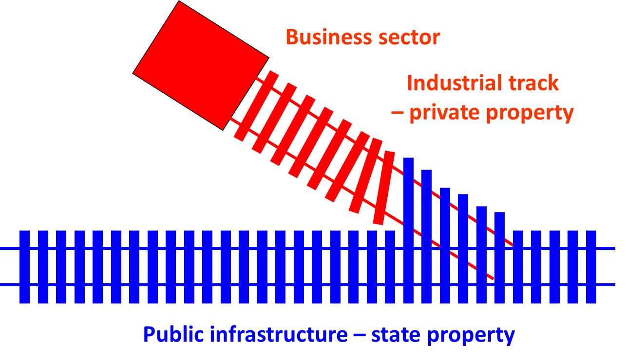

Slide 3
ADVANTAGES OF USING INDUSTRIAL TRACKS
The advantages of industrial tracks for users:
direct delivery of wagon consignments to the place of production activities within the company,
shorter time of goods handling,
minimal damaging of goods,
avoiding of significant handling costs,
saving on handling costs by using adequate proper machinery, and total lower transport costs due to the selection of railways as cost affordable land carrier.

Slide 4
ADVANTAGES OF USING INDUSTRIAL TRACKS
Advantages of industrial tracks for the railways:
possibility of starting direct trains,
disburdening of station handling tracks,
shorter time of wagon turnover,
direct connection of internal and international rail transport, and
formation of a solid and permanent contact with the big users.

Slide 5
ANALYSIS OF OPERATIONS ON INDUSTRIAL TRACKS IN THE REPUBLIC OF CROATIA
Table 1. Number of recorded industrial tracks and their users in 2009
Scope | 2009
Recorded industrial tracks | 314
Active industrial tracks | 277
Dormant industrial tracks | 37
Co-users | 126

Slide 6
Table 2. Total loading and unloading operations on industrial tracks of HŽ Cargo d.o.o.
REGIONAL OFFICE | INDICATORS | YEAR
 |  | 2008 | 2009 | 2010 | 2011 | 2012
INDUSTRIAL TRACKS TOTAL | WAGONS | 247,582 | 228,291 | 216,966 | 225,583 | 262,122
 | TONS | 10,209,747 | 9,600,896 | 9,051,526 | 9,376,290 | 10,828,426

Slide 7
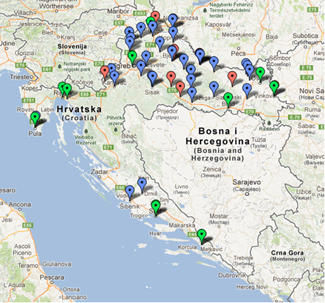
Existing condition in entrepreneurial and free zones

Slide 8
Research methodology
The research was carried out with the goal of establishing the need for the construction of new and the modernisation of the existing industrial tracks, with emphasis on the need for construction of industrial tracks in the area of business and free zones at a 2 kilometre distance from railway line.
The research encompassed all business and free zones within the subject distance.
Field research was carried out in cooperation with HŽ Cargo.
The survey included 518 business entities operating in business and free zones, of which 134 responded to the survey.

Slide 9
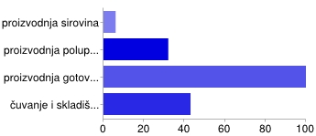
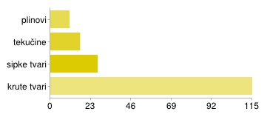
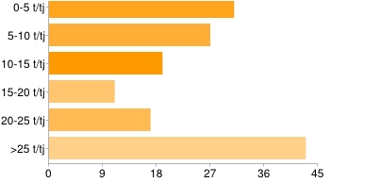
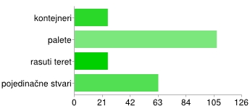
What is your field of work?
What type of products you use?
How many products you produce?
Type of packaging products?

Slide 10
96% of business entities dispatch the goods by truck,
20% by train,
2% by ship,
8% by train and ship combination,
6% by truck and ship combination,
4% by truck, train and ship combination
1% by ship and train combination.
- business entities mainly deliver and dispatch goods using the same type of means of transport, in most cases – trucks.

Slide 11
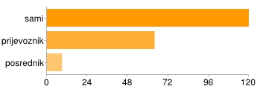
To the question “Who performs the reloading?”,
Response analysis established that the business entities performing the goods' reloading themselves are those which transport the goods on palettes and in trucks.
Reloading of goods is performed by the carried mostly for those entities operating in wood industry

Slide 12

To the question “Who organises the transport?”,
- The result of answers to this question is interesting both for the carriers and the companies dealing in logistics in the Republic of Croatia, considering that a large number of business entities is organising the transport by themselves.

Slide 13
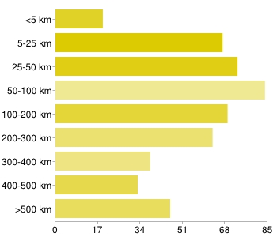
Answers to the question “At what distances do you transport cargo?” show that:

Slide 14
Free zone users had to respond to the question “On which routes do you transport cargo?” by indicating the route of cargo transport.
Routes indicated by the users are mainly within the Republic of Croatia, with a part outside of the Republic of Croatia.
The analysis showed that the survey participants, 34% of them, believe that construction and use of an industrial track would help the development of their company
“Your opinion about the railway transport and proposal for better cooperation?”

Slide 15
CONCLUSION
The conducted research shows that industrial tracks are a logical extension of the railway infrastructure, as well as an important part of the railway traffic system and the traffic system as a whole.
A higher quality railway traffic system improves the economic picture of a particular region, saves money for traffic infrastructure, reduces energy consumption, protects the environment and increases traffic safety
Railway – not industry oriented

Slide 16
Thank you for your attention!
brnjac@fpz.hr

